Slide 1
ML-Leaks: Model and Data Independent Membership Inference Attacks and Defenses on Machine Learning Models
Ahmed Salem∗, Yang Zhang∗§, Mathias Humbert†, Pascal Berrang∗,
Mario Fritz∗, Michael Backes∗
∗CISPA Helmholtz Center for Information Security,
{ahmed.salem, yang.zhang, pascal.berrang, fritz, backes}@cispa.saarland
†Swiss Data Science Center, ETH Zurich and EPFL, mathias.humbert@epfl.ch
Network and Distributed Systems Security (NDSS) Symposium 2019
Wen Shi
2019/10/15

Slide 2
Content
Background
State Of The Art
Contribution
Attacks
Defense Mechanisms

Slide 3
Background
ML models are trained on sensitive data
Financial data
Location and activity data
Biomedical data
ML models are vulnerable to various security and privacy attacks
Model Inversion Attack
Model Extraction Attack
Adversarial Examples Attack

Slide 4
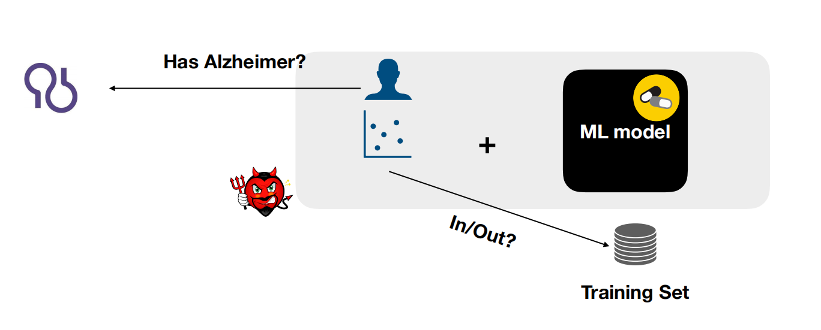
Background
Membership Inference Attack
An adversary aims to determine whether a data item (also referred to as a data point) was used to train an ML model or not.
Successful membership inference attacks can cause severe consequences

Slide 5


Background
Machine learning as a service : the user uploads a dataset and obtains an API for querying the resulting model.
Google Prediction API
Amazon ML

Slide 6
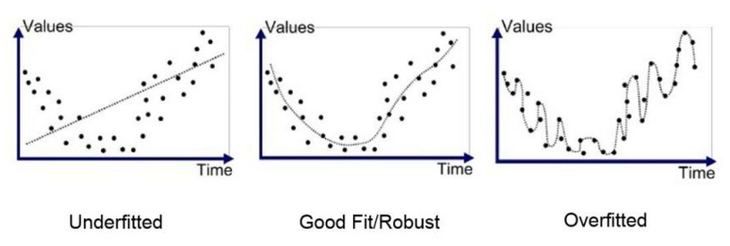
Background
Overfitting

Slide 7
State Of The Art
Shokri et al. present the first membership inference attack against machine learning models in 2017[1].
Setting: Adversary's access to the model is limited to black-box queries that return the model's output on a given input.(such as Amazon ML and Google Prediction API)
Setting: Adversary's access to the model is limited to black-box queries that return the model's output on a given input.(such as Amazon ML and Google Prediction API)
Goal: Given a data cord ,determine if the record was in the model’s training dataset.
Goal: Given a data cord ,determine if the record was in the model’s training dataset.
Way: create multiple “shadow models” that imitate the behavior of the target model, then train the attack model on the labeled inputs and outputs of the shadow models.
Result: Implement attacks effectively on black-box models trained in the cloud using Google Prediction API and Amazon ML.

Slide 8
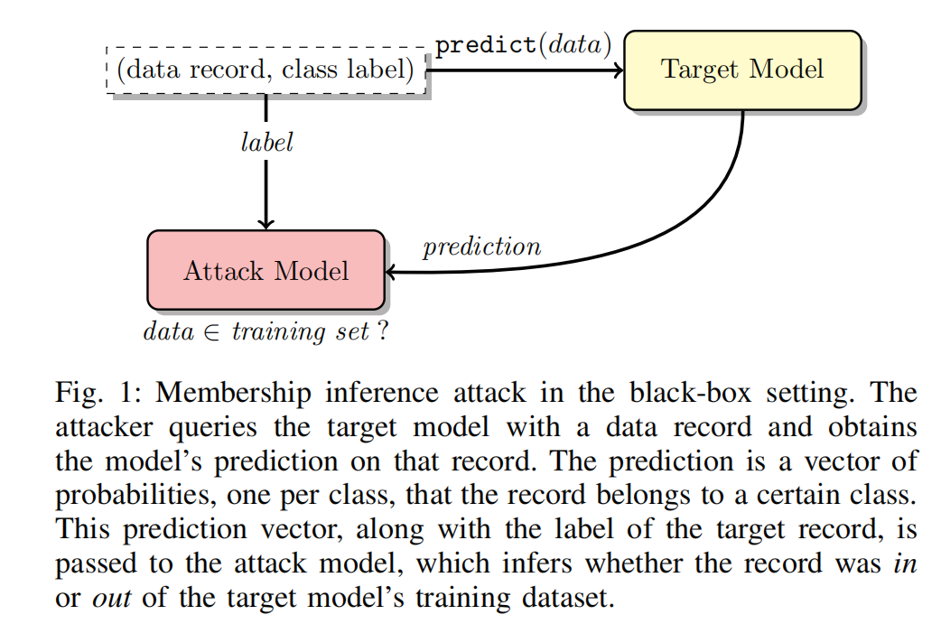
State Of The Art（Shokri et al.）

Slide 9
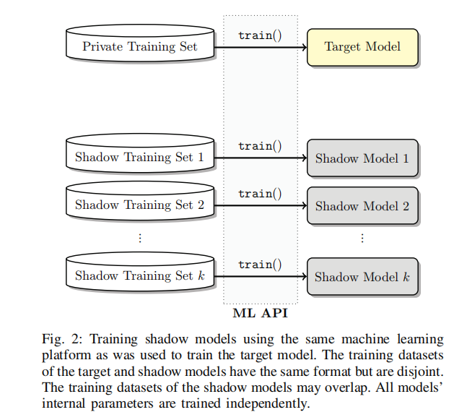
State Of The Art（Shokri et al.）

Slide 10
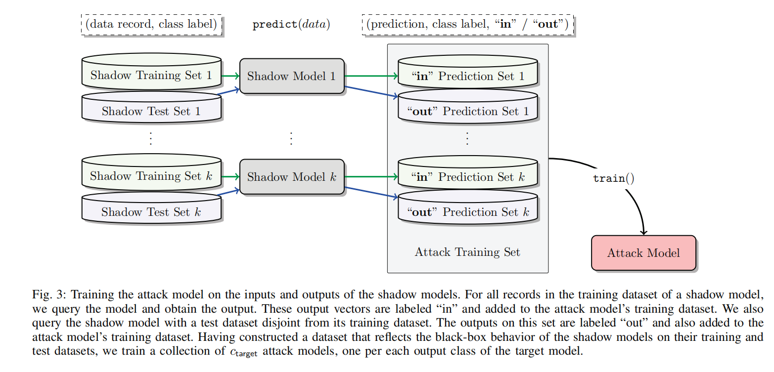
State Of The Art（Shokri et al.）

Slide 11
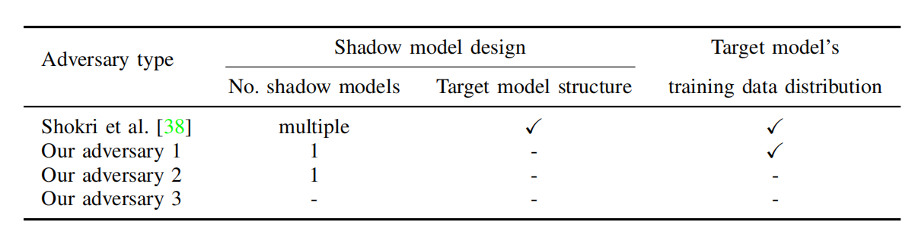
Contribution
This paper study three different types of adversaries based on the design and training data of shadow models.
Propose two defense mechanisms, namely dropout and model stacking, and demonstrate their effectiveness experimentally.

Slide 12
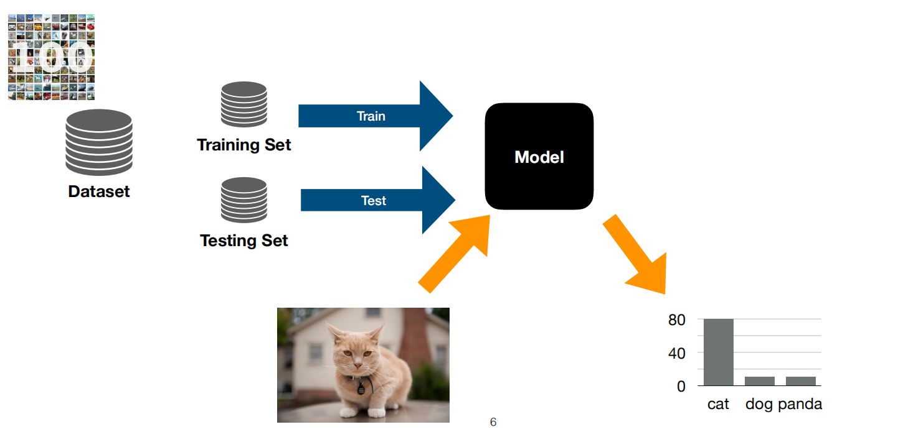
Attacks
An ML classifier is essentially a function M that maps a data point X (a multidimensional feature vector) to an output vector M(X) = Y.

Slide 13
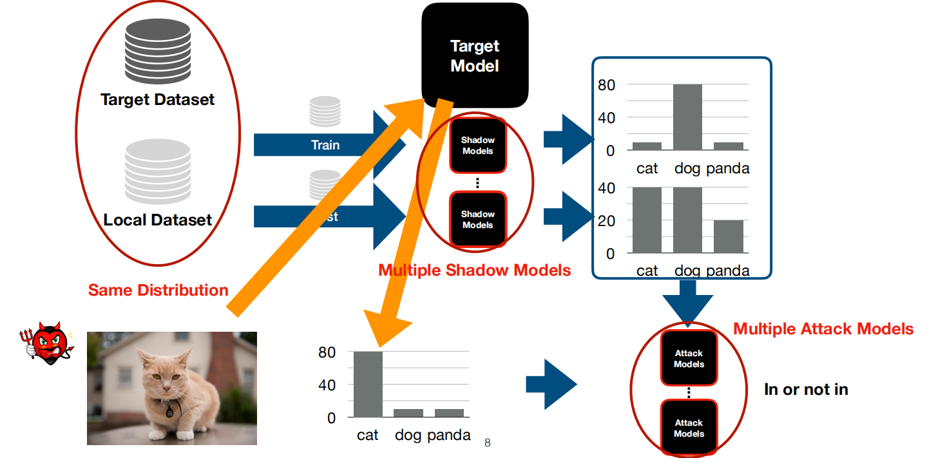
Attacks
Membership inference attack

Slide 14
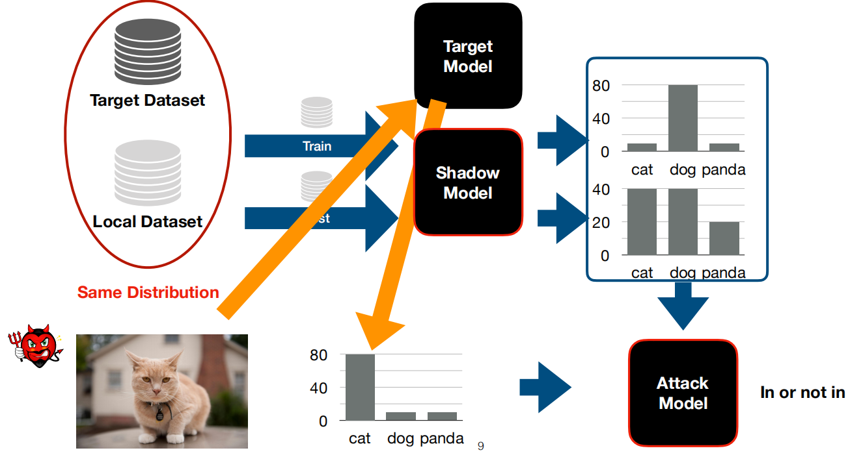
Attacks
First Attack(Adversary 1)
• Assume a dataset that comes from the same distribution as the target model's training data.
• The adversary knows the target
model's algorithm and
hyperparameters and implements
her shadow model in the same
way.
• Start by using only one instead of
multiple shadow models to mimic
the target model's behavior.

Slide 15
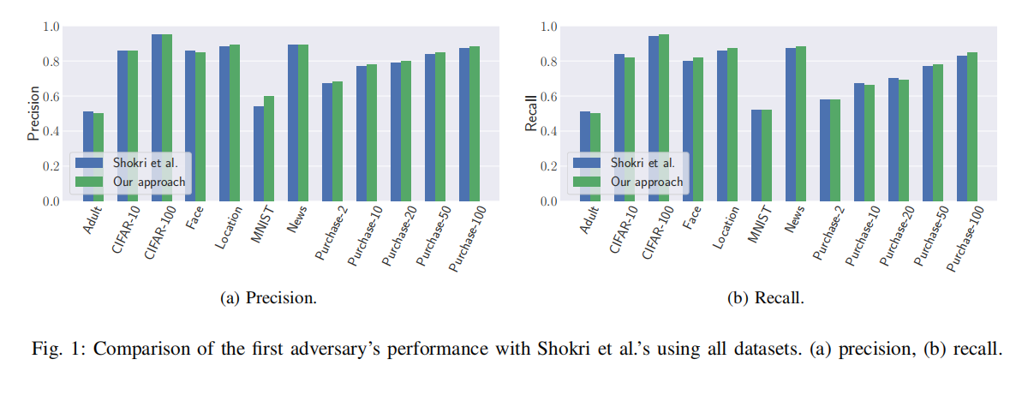
Attacks

Slide 16
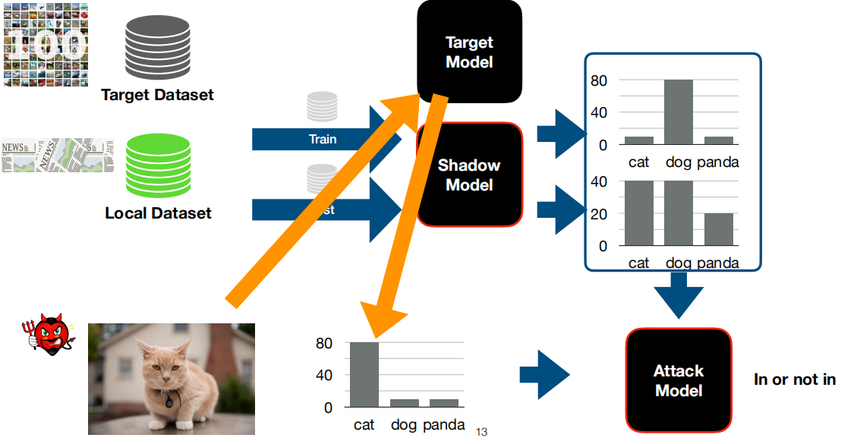
Attacks
Data Transferring Attack (Adversary 2)
• Use an existing dataset that comes from a different distribution than the target model's training data to train her shadow model.
• The shadow model summarize the
membership status of a data point in the training set of a machine learning
model.

Slide 17
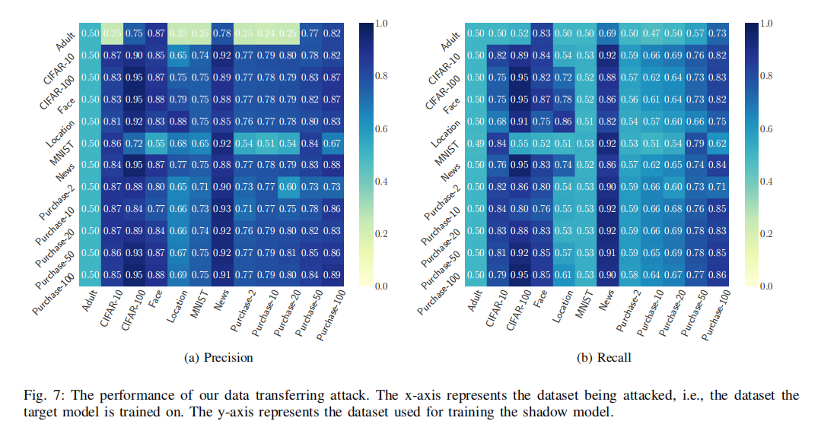
Attacks

Slide 18
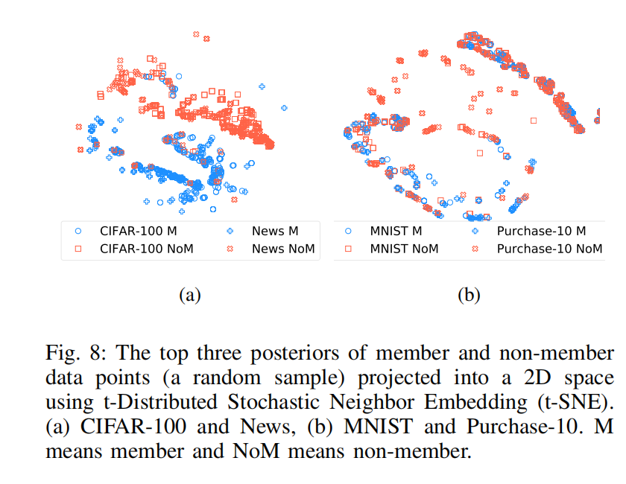
Attacks

Slide 19
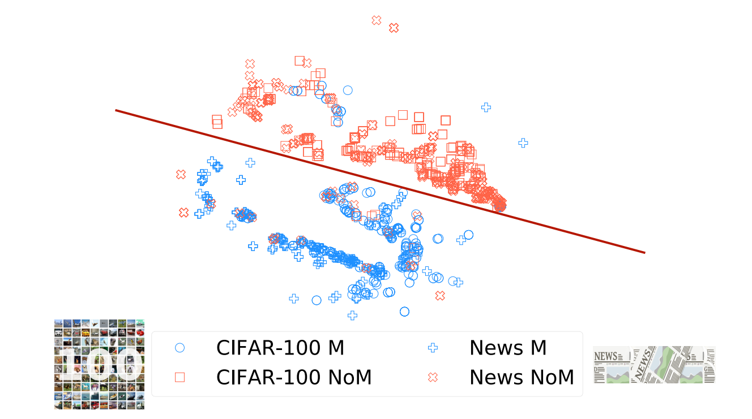
Attacks
Reason
• The member and non-member points of these datasets are tightly clustered
together and follow a common decision boundary.
• The attack model trained on one dataset can effectively infer the
membership status of points in the other dataset.

Slide 20
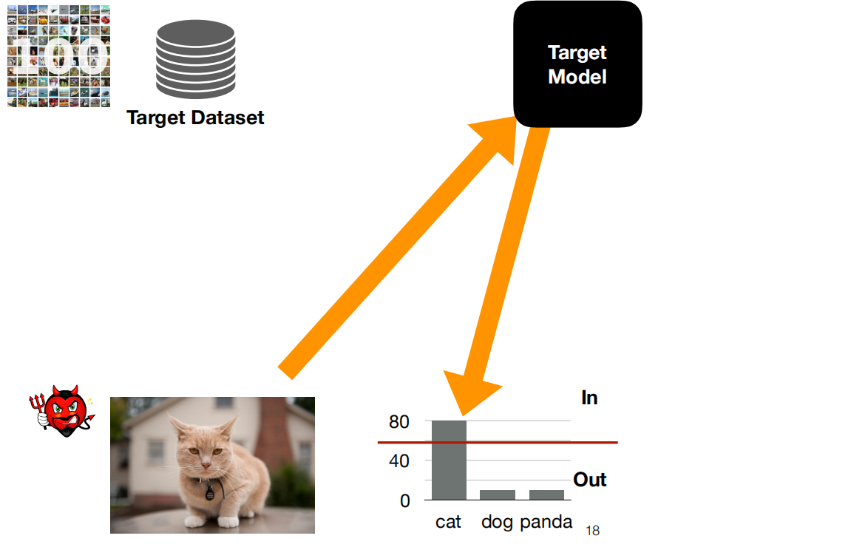
Attacks
Third Attack (Adversary 3)
• All the third attack could rely on is the target model's output posteriors after querying her target data point.

Slide 21
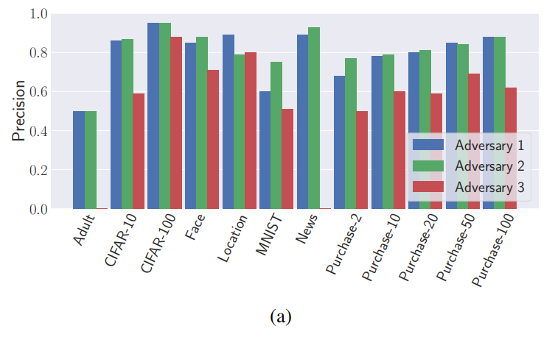
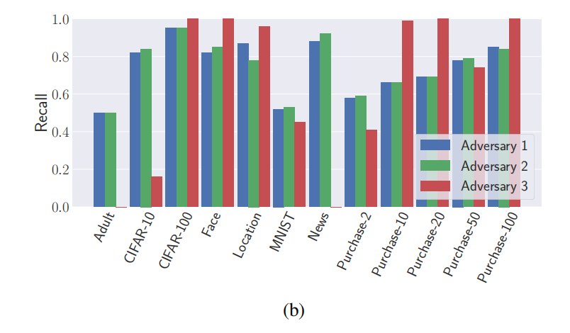
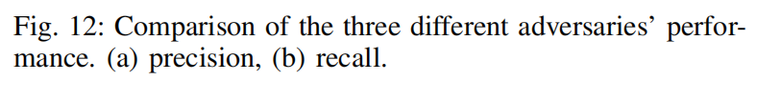
Attacks
Comparing All Attacks

Slide 22
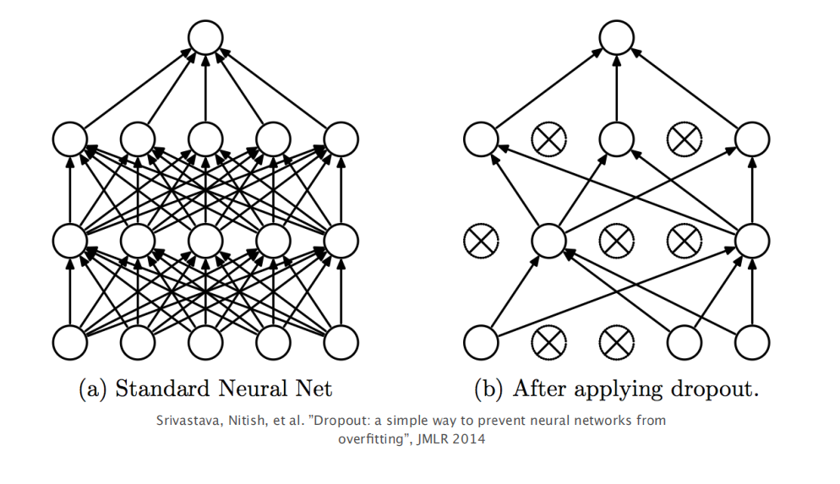
Defense
Dropout
• Dropout is a very effective method to reduce overfitting based on
empirical evidences. It is executed by randomly deleting in each
training iteration a fixed proportion (dropout ratio) of edges in a
fully connected neural network model.

Slide 23
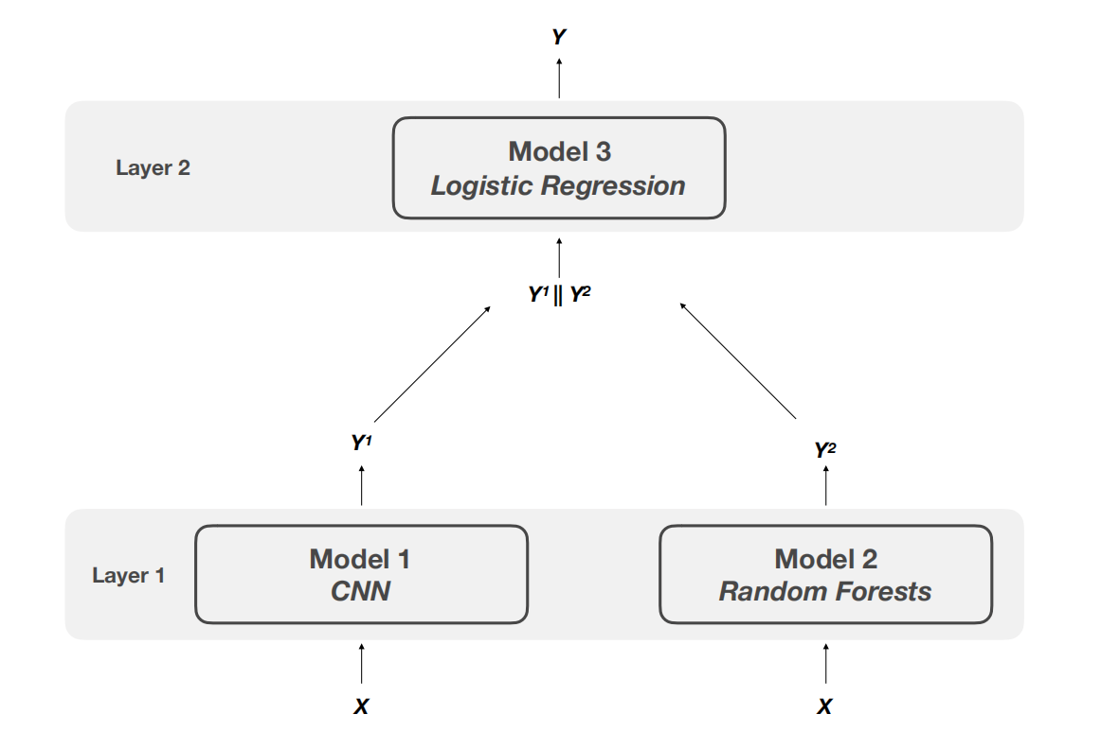
Defense
Model Stacking
• The intuition behind this defense is that if different parts of the target model
are trained with different subsets of data, then the complete model should
be less prone to overfitting.This can be achieved by using ensemble learning.
neural network model.

Slide 24
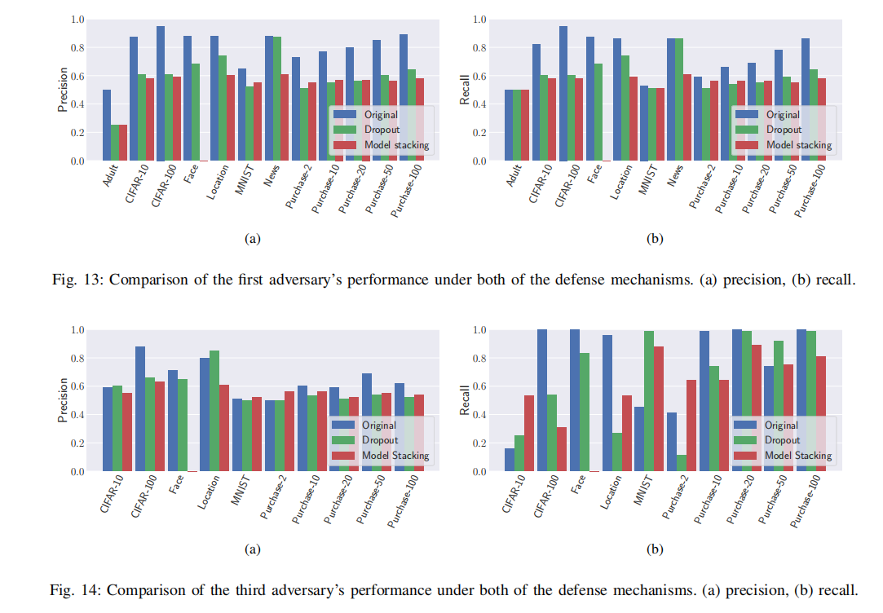
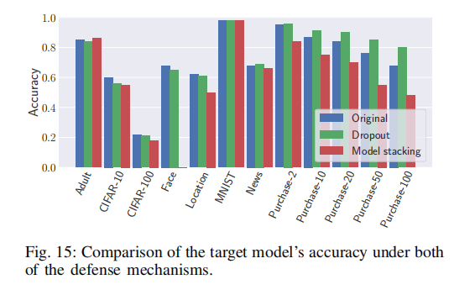
Defense
Performance

Slide 25
THANKS

